Slide 1
Spring Cloud
Manu Mathew

Slide 2
Agenda
Introduction
Spring cloud projects
Hands-on

Slide 3

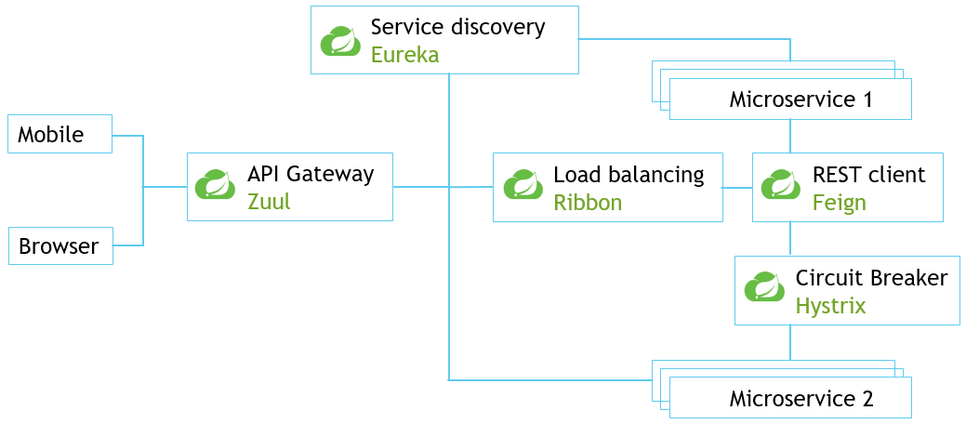
Spring cloud
Suite of projects contains many services that help our application run on cloud
With a few simple annotations we can quickly enable and configure the common patterns inside our application

Slide 4
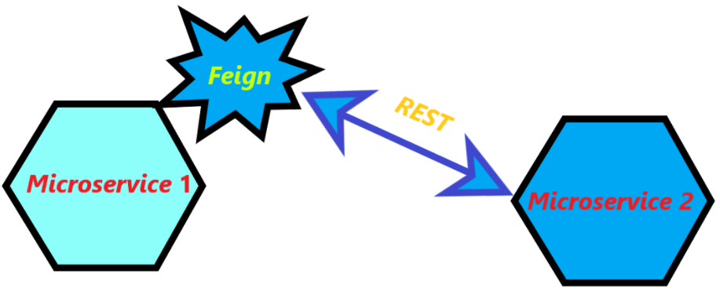
Feign
Declarative REST client used in microservices communication
Provides abstraction over REST-based calls
Writing web service clients easier
Annotation
  @EnableFeignClients
  @FeignClient
Maven dependency
  <dependency>
  <groupId>org.springframework.cloud</groupId>
  <artifactId>spring-cloud-starter-openfeign</artifactId>
  </dependency>

Slide 5
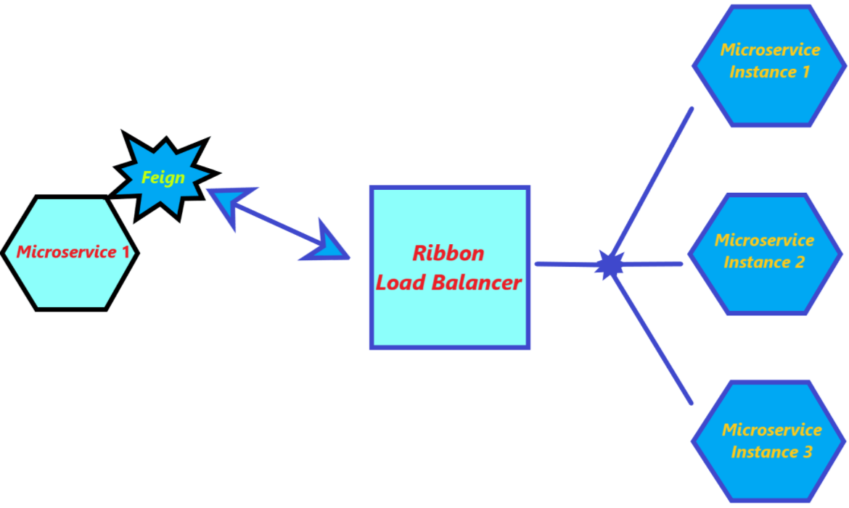
Ribbon
Client-side load balancer
Distribute load to the instances
Feign uses Ribbon
Annotation
  @RibbonClient
Maven dependency
  <dependency>
  <groupId>org.springframework.cloud</groupId>
  <artifactId>spring-cloud-starter-netflix-ribbon</artifactId>
  </dependency>

Slide 6
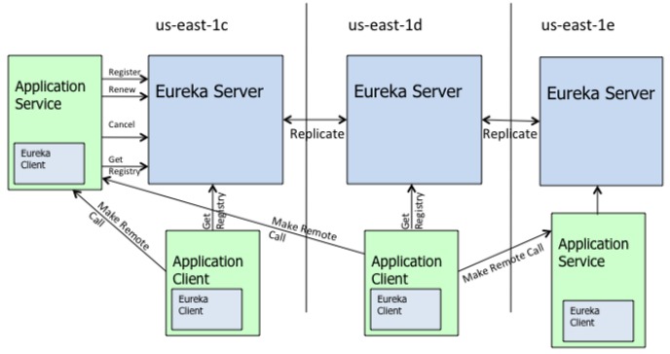
Eureka
Service discovery server and client
REST based service
Eureka client instances will register with eureka server
Client and server have local cache of the instance's registry
Annotation
Server - @EnableEurekaServer
Client - @EnableEurekaClient
Maven dependency
  Server -
    <dependency>
    <groupId>org.springframework.cloud</groupId>
    <artifactId>spring-cloud-starter-netflix-eureka-server</artifactId>
    </dependency>
  Client -
    <dependency>
    <groupId>org.springframework.cloud</groupId>
    <artifactId>spring-cloud-starter-netflix-eureka-client</artifactId>
    </dependency>

Slide 7
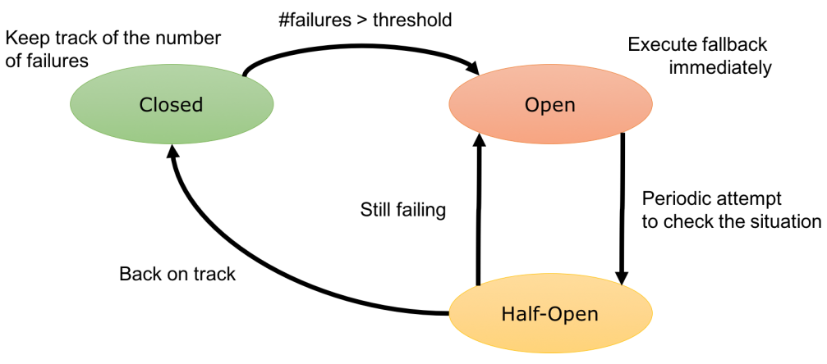
Hystrix
Control the interactions between distributed services by adding latency tolerance and fault tolerance logic
Stop cascading failure and enable resilience in microservice applications
Provide circuit breaking and fallback support
Annotation
@EnableCircuitBreaker
@HystrixCommand
Maven dependency
    <dependency>
    <groupId>org.springframework.cloud</groupId>
    <artifactId>spring-cloud-starter-netflix-hystrix</artifactId>
    </dependency>

Slide 8
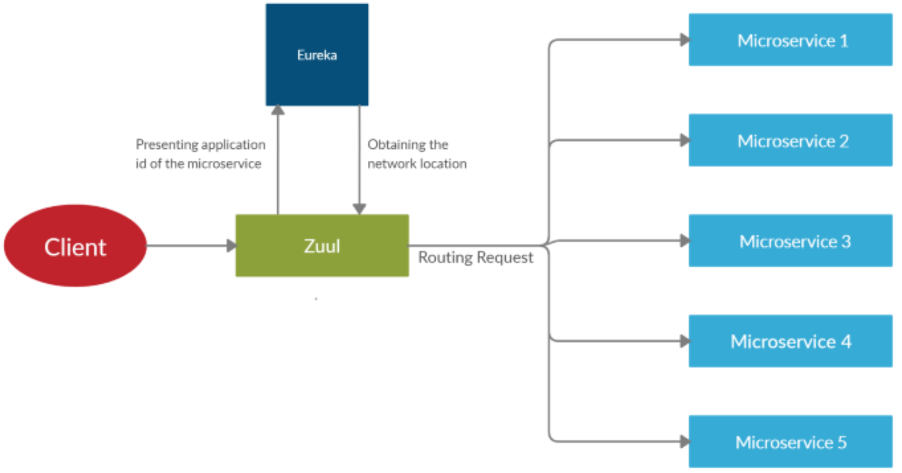
Zuul
The front door for all requests from devices and web sites to the backend of the application
Provides dynamic routing, monitoring, resiliency and security
Supports eureka, ribbon and hystrix
Annotation
@EnableZuulProxy
Maven dependency
    <dependency>
    <groupId>org.springframework.cloud</groupId>
    <artifactId>spring-cloud-starter-netflix-zuul</artifactId>
    </dependency>

Slide 9
Thank you

